Slide 1
Homework 1
CSIE 7190 Cryptography and Network Security, Spring 2023

Slide 2
Introduction
4 handwriting problems and 4 programming problems.
For programming problem, any programming language is acceptable.
Topic includes:
Security requirements, basic cryptography knowledges, hash functions, symmetric and asymmetric cryptography, and other related topics.

Slide 3
Submission Guidelines
Submit your homework to NTU COOL.
You need to put all of them in a single folder named by your student ID, and then zip them before upload to Cool.
Be careful on the folder structure (see later slides)
For example: hw1_r11922xxx.zip.

Slide 4
Submission Guidelines
The folder should include all the contents listed below.
Your report (must be a PDF), including:
your answers for handwriting problems.
your write-up for programming problems to explain how you solve them, also the flag for each problem if required.
Your codes for programming problems if required.
A readme.txt file to provide a brief usage of your code. (e.g., how to compile, if needed, and execute)
You may lose points if TAs can’t run your code.

Slide 5
Submission Guidelines
For example, the file layout in your folder should look like this:
r11922xxx
├── report.pdf
├── code
│ ├── code{problem_number}.ext
│ └── readme.txt
└── (other necessary files)
Be sure to unzip and double check your hw1_r11922xxx.zip before uploading!!!

Slide 6
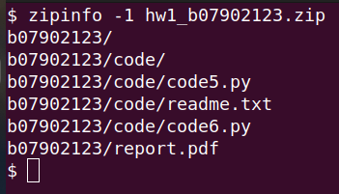
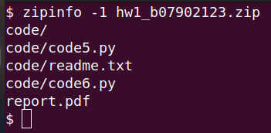
Submission Guidelines
Correct!
Wrong!
Be sure to unzip and double check your hw1_r11922xxx.zip before uploading!!!

Slide 7
Reminder: Double Check Your Zip File
Your zip file may accidentally include some system-specific files such as __MACOSX folder or other hidden files.
Your files should be inside a folder after it is unzipped. If not, the files will be scattered across the folder and TA will be very confused.
Notes:
zip -d xxx.zip __MACOSX/\* \*/.DS_Store

Slide 8
Submission Guidelines
Submission deadline: 2023/04/09 23:59
Late penalty: 10% penalty per day, up to two days

Slide 9
TA Hours
蔡奇夆: Mon. 13:20 ~ 14:20, 地下室中柱
陳正康: Tue. 17:30 ~ 18:30, 地下室中柱
林郁敏: Wed. 14:00 ~ 15:00, 博理館地下室
李安傑: Thu. 13:30 ~ 14:30, 地下室中柱
周楷翔: Fri. 18:00 ~ 19:00, 地下室中柱
Recommend to send email first, so every TA can see your problems.
Don’t ask TA to debug for you 😓

Slide 10
Problems and TAs
Multi-prime RSA - 周楷翔
Fun With Semantic Security - 蔡奇夆
Simple Crypto - 林郁敏
ElGamal Cryptosystem - 李安傑
Bank - 陳正康
Clandestine Operation - 林郁敏

Slide 11
Recommended Tools

Slide 12
Linux command -- nc
$ nc [server-ip] [port]

Slide 13
Pwntools
# Try it out by yourself in Python shell!
from pwn import *
r = remote('cns.csie.org', 44398)
r.recvuntil('[?] ')
txt = r.recvline()
print(txt)
r.sendlineafter('>>> ', '10')
r.interactive()
Installation:
pip install pwntools
Reference

Slide 14
Requests
Installation:
pip install requests
Reference
import requests
cookies_dict = {"my_cookie": "cookie_value"}
response = requests.get("http://example.org/", cookies=cookies_dict)
response.text

Slide 15
Write Math Equations With LaTeX
Overleaf (recommended)
Typora (recommended before 2022)
HackMD
Notes:
Overleaf 早開始學早享受
現在 Typora 要錢，可以 google 搜尋 typora alternative

